Slide 1
A Short Course to Learn SQL Basics
Lesson 1: Intro to SQL & Relational Databases
Kevin Patrick
Ryan Kuhns
Michael Headlee

Slide 2
Course Outline
Intro to SQL and relational databases
Functions and sorting data
Conditional column calculations and subsets of rows
Summarizing data across rows (i.e.: grouping)
Combining data from multiple tables
Using subqueries
Review of lessons 1-6 and examples with more complex functions
Stored procedures and parameters
Modifying and maintaining data
Overall review and real world and student submitted examples

Slide 3
Course Outline
Intro to SQL and relational databases
Functions and sorting data
Conditional column calculations and subsets of rows
Summarizing data across rows (i.e.: grouping)
Combining data from multiple tables
Using subqueries
Review of lessons 1-6 and examples with more complex functions
Stored procedures and parameters
Modifying and maintaining data
Overall review and real world and student submitted examples

Slide 4
Background on SQL
Stands for Structured Query Language
Used to interact with relational database management software
Three categories of SQL statements
Data manipulation language (DML)
i.e.: query data and modify data with SELECT, INSERT, UPDATE, DELETE, TRUNCATE, and MERGE statements
Data definition language (DDL)
Create and define database objects
Data control language (DCL)
Assigns object permissions, etc.
Focus of our classes
We will cover creating tables in week 9.

Slide 5
Relational database
There is formal definition of relational database
Goal is to represent data with minimal redundancy
For our purposes you can think of it collection of related tables defining set of data
Many types of relational database set-ups
Notes:
Discuss how tables are organized into columns which represent fields and rows which represent observations or records

Slide 6
Relational Database: Example 1
Customer Table
CustomerID
FirstName
LastName
Order Table
CustomerId
OrderId
Order Details
OrderId
OrderDate
ShipDate
ProductID
UnitsOrdered
Product Table
ProductID
ProductDescription
UPC
ProductWeight
ProductPrice

Slide 7
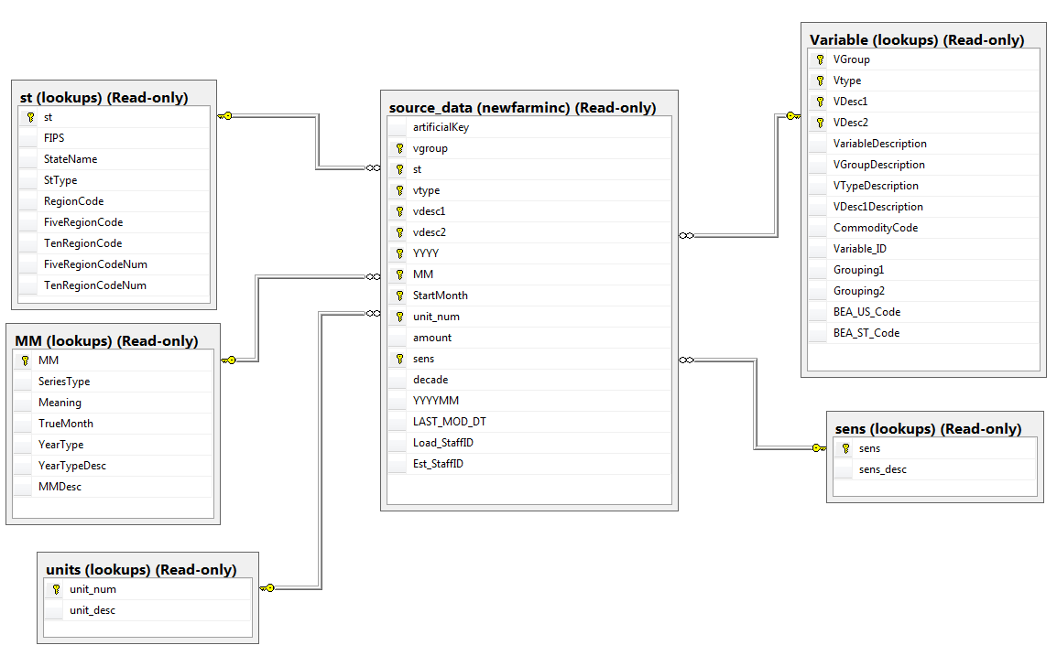
Relational Database: Example 2

Slide 8
Each column defines the type of data that can be stored
DataType Group | Datatype | Nullability | Example
Numeric | int | Not Null | 57
 | decimal | Not Null | 57.62
 | decimal | Null | Null
Character | varchar | Not Null | ‘Billy Madison’
 | char | Not Null | ‘20002’
 | Char | Null | Null
Date/Time | date | Not Null | ‘2016-06-15’
 | datetime | Not Null | ‘2016-06-15 09:13:50’
Notes:
There are numerous datatypes that can be defined for a column, but they fall into three broad categories:
Numeric
Int is a common one that stands for integers which do not have decimal places
Decimal is a numeric datatype that allows for decimal places
Character datatypes can include any letter from the alphabet, numeric digits, and special characters like the *
Notice that values for character datatypes require single quotes
Date and time datatypes as you might have guessed are used to represent date and time values. Values also must be surrounded by single quotes
The date datatype allows for date functions to be applied, which we’ll cover at a later time.

Slide 9
Additional column attributes
Primary Key
Uniquely identifies a single row in a table
This simplifies data retrieval and allows multiple tables to relate to each other
Insures all rows are unique. For example, if there had been two Kevin Patrick’s in the customers table, the primary key would have different values .
Foreign Key
Insures that a column only contains a valid value
Different from datatype attributes

Slide 10



A note on accessing data tables
Col1 | Col2
Server
database
Schema
Table
Notes:
In order to access a data table in SQL server management studio, you need to know the following information about where it’s stored.
You can think of each category as a folder; each is nested within the category above it.
The server is the broadest category. In this case the name of the server is SQLprod01.
That server then contains numerous databases. The one listed here is the database used by the farm income team.
Within a database are schemas. These again are similar to folders and allow for control of who has access to groups of tables in the database.
Finally, tables that hold the data are located within schemas.
Walk-through example in SQL Server Management Studio

Slide 11
Components of a SQL Query
Select
From
<Where>
<Group By>
<Having> <Order By>
Statements in SQL query must appear in this order.
Statements with <> are optional. Include only those necessary for your query.

Slide 12
Components of a SQL Query
Select
From
<Where>
<Group By>
<Having> <Order By>
Tells SQL which existing or calculated columns to return
Tells SQL where to query data from
Subsets rows of data
Groups data (i.e.: to sum by group)
Subset based on grouped data (i.e.: Having group sum < 10)
Orders rows by specified columns

Slide 13



Software you can use to practice SQL
SQL Server Management Studio
Microsoft Access
SAS
Notes:
There are countless software packages that that advantage of SQL. In this course, we will focus on three:
Microsoft Access, SAS, and SQL Server Management Studio

